Slide 1
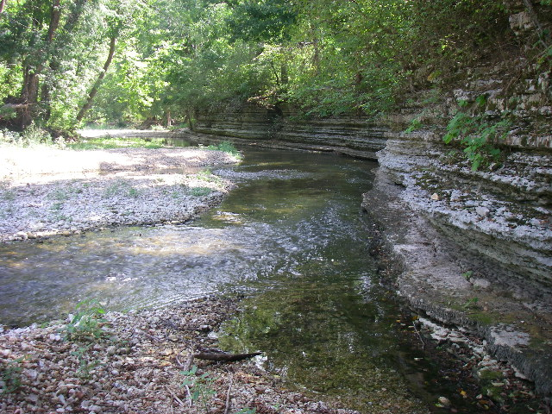
Arkansas Dept. of Environmental Quality
Regulation No. 2 and 303(d) List
Sarah Clem
Planning Branch Manager
ADEQ Water Division
Yocum Creek, Carroll County

Slide 2
Overview
Standards
Designated Uses
Criteria
Triennial Review
Assessment of States Waters
303(d) Listing
Updates

Slide 3
Clean Water Act Requirements
Defines Water Quality goals
40 CFR 130.3 and 131
Adopt Water Quality Standards
Data collection based on need
40 CFR 130.4
Monitor Waters of the State
Determines attainment
40 CFR 130.8
Assessment
305(b) Integrated Report
Identifies Quality Limited Waters
40 CFR 130.7(b)(1)
List Impaired Waters
303(d) List
Defines Waste Loads
40 CFR 130.7
Develop TMDLs
Implementation
40 CFR Part 122
Develop Permit Limits

Slide 4
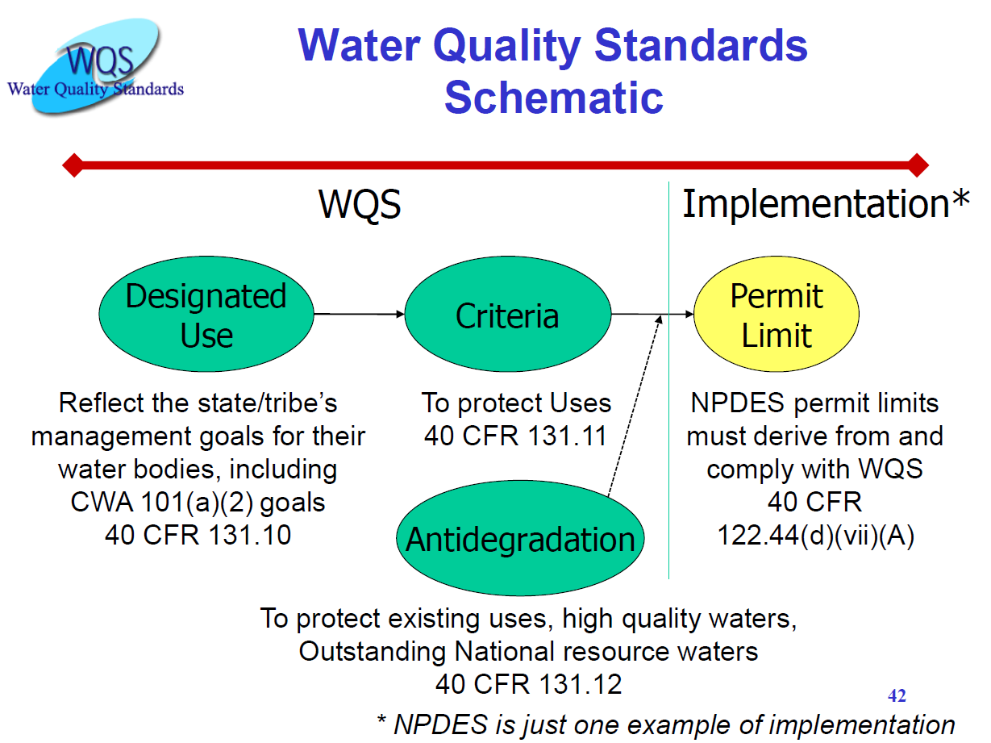

Slide 5
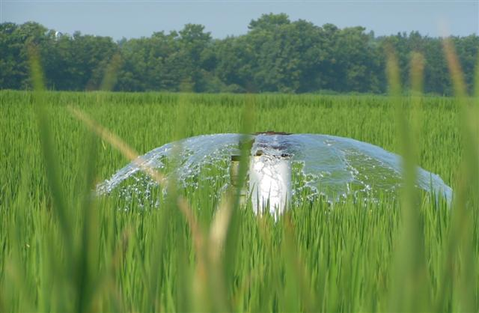
What are Water Quality Standards?
Water Quality Standards define the goals for waterbodies in the state by designating uses for waterbodies, such as:
  Agricultural Water Supply
  Extraordinary Resource Water

Slide 6
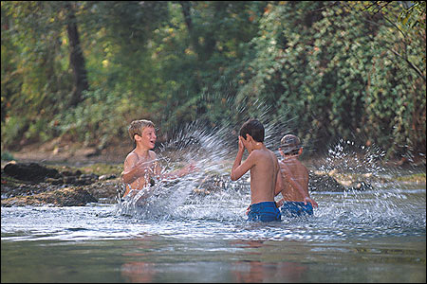
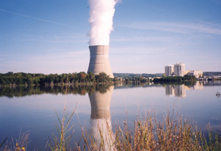
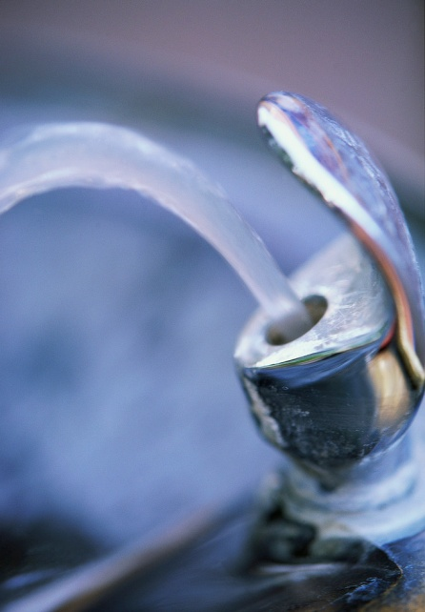
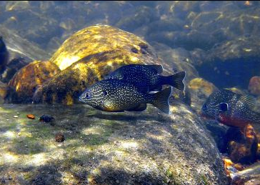
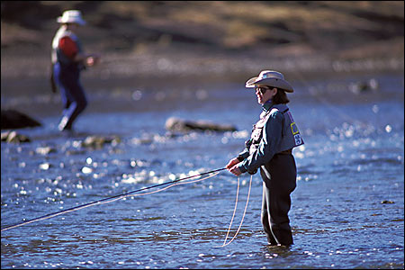
Other Designated Uses
Primary Contact Recreation
Industrial Water Supply
Domestic
Water Supply
Secondary Contact Recreation
Fisheries

Slide 7
What is Regulation No. 2?
The Federal Clean Water Act (1972) requires each state to establish Water Quality Standards (WQS)
Arkansas’s WQS are found in Regulation No. 2.
  ADEQ Water Division Planning Branch maintains Reg. 2
  Arkansas Pollution Control and Ecology Commission
  EPA must approve Reg. 2
Regulation No. 2 includes designated uses and the criteria to protect those uses for surface waters of the state of Arkansas.
Criteria are: numeric and/or narrative

Slide 8
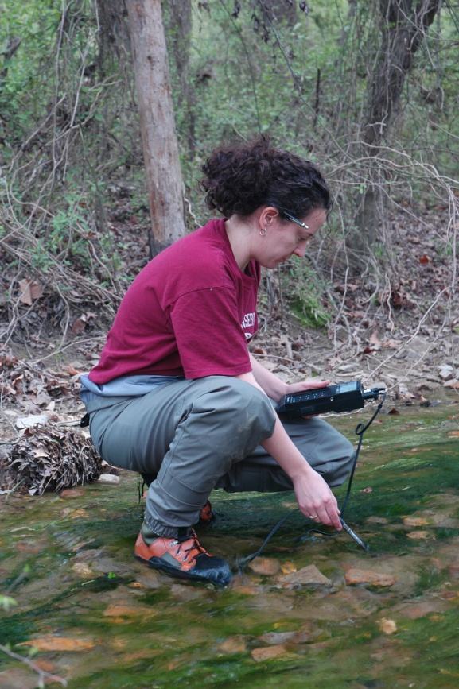
Water Quality Criteria
Water Quality Standards include numerical and narrative criteria that protect Arkansas’s waters
  Minerals
  Bacteria
  Temperature
  Nutrients
  Toxic Substances
  pH

Slide 9
Regulation No. 2
Clean Water Act (1972) requires states to establish Water Quality Standards
Standards must be reviewed every 3 years
  No changes
  Update existing standards
  Add appropriate new standards
  Revise standards that are difficult to interpret
  Correct grammatical and typographical errors

Slide 10
Triennial Review Process
Public Listening Sessions Feb 2012
Stakeholder Workgroup May-July 2012
Petition the APC&E Commission Sept-Oct 2012
Public Notice Oct-Nov 2012
Public Hearing(s) Nov-Jan 2013
45-day Comment Period Nov-Jan 2013
Responsive Summary by ADEQ Jan-Mar 2013
Legislative Review May-July 2013
Adoption by the ADPC&E Commission Aug-Sep 2013
Submit to EPA for Approval Feb 2014
EPA Approval of Triennial Review Oct 2016

Slide 11
Remaining Issues with EPA
Minerals – EPA requesting a State strategy to develop minerals criteria that are explicitly protective of aquatic life
Turbidity – renaming “All-flow” criteria to “Storm-flow”
or
revise to include seasons for criteria
Lakes standards – “applicable at 1 meter”
– revise to “apply for assessment purposes only”

Slide 12
Clean Water Act Requirements
Defines Water Quality goals
40 CFR 130.3 and 131
Adopt Water Quality Standards
Data collection based on need
40 CFR 130.4
Monitor Waters of the State
Determines attainment
40 CFR 130.8
Assessment
305(b) Integrated Report
Identifies Quality Limited Waters
40 CFR 130.7(b)(1)
List Impaired Waters
303(d) List
Defines Waste Loads
40 CFR 130.7
Develop TMDLs
Implementation
40 CFR Part 122
Develop Permit Limits

Slide 13
Inventory of Quality of
All Waters of the State
Requires Water Quality Monitoring Network
  Adequate Magnitude?
    Coverage of all waters
    Frequency of sampling
    Parameters to sample (physical, chemical, biological)
    Conditions when sampling
Best Professional Judgment
  Concentration of potential pollution activities
  Perceived problem areas

Slide 14
Inventory of Quality of All
Waters of the State
Five Water Quality Monitoring Networks
  Ambient Water Quality Monitoring Network
  Watershed Monitoring Network
  Lakes Water Quality Monitoring Network
  Groundwater Quality Monitoring Network

Slide 15
Water Quality Monitoring Network
CHEMICAL ANALYSES
Routine Analyses
  Conventional parameters (pH, D.O., Temp.)
  Minerals (Cl, SO₄, TDS)
  Nutrients (forms of N and P)
  Heavy metals (Cu, Zn, Pb, etc.)
  Other associated ions (Na, Ca, K, etc.)

Slide 16
Water Quality Monitoring Network
AMBIENT SURFACE WATER NETWORK
Approximately 150 stations
Chemical parameters and flow (when available)
Sampled monthly for approximately 30-35 years
Monitoring objectives
  Big river systems
  Below point source discharges
  Potentially problematic nonpoint source areas
  Least-disturbed reference streams
  Consistent long-term monitoring

Slide 17
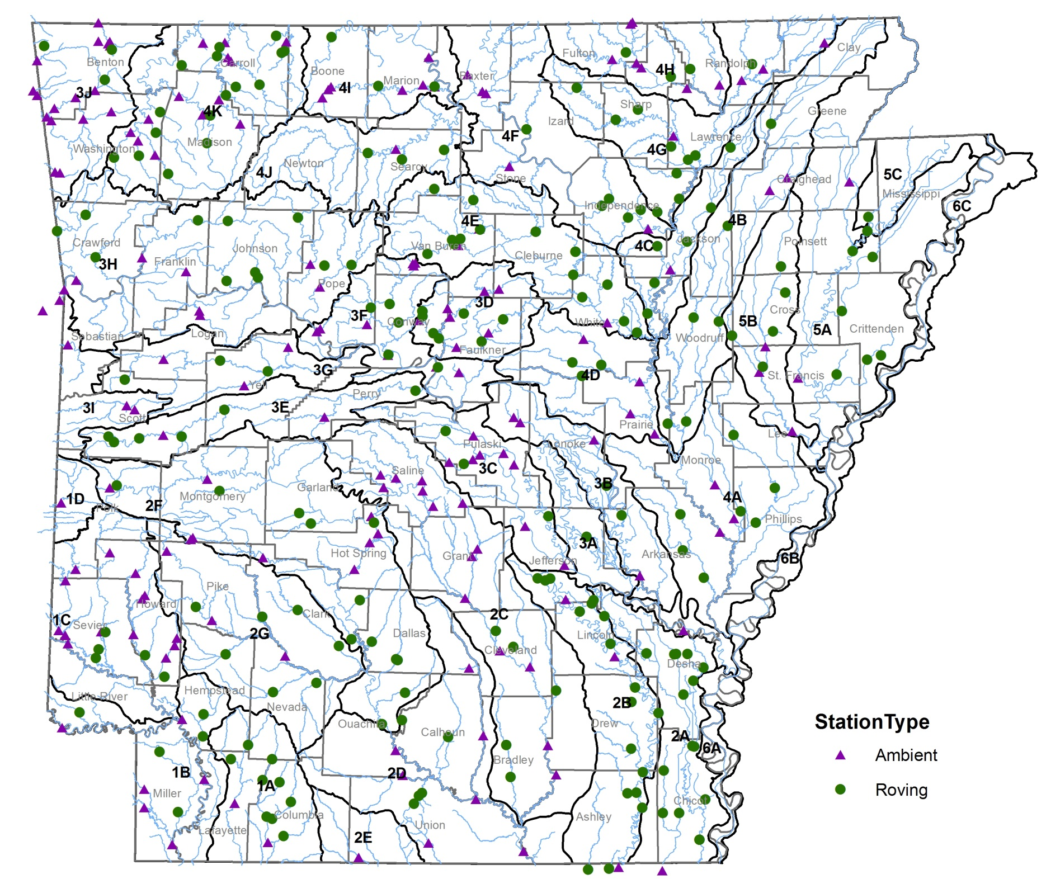

Slide 18
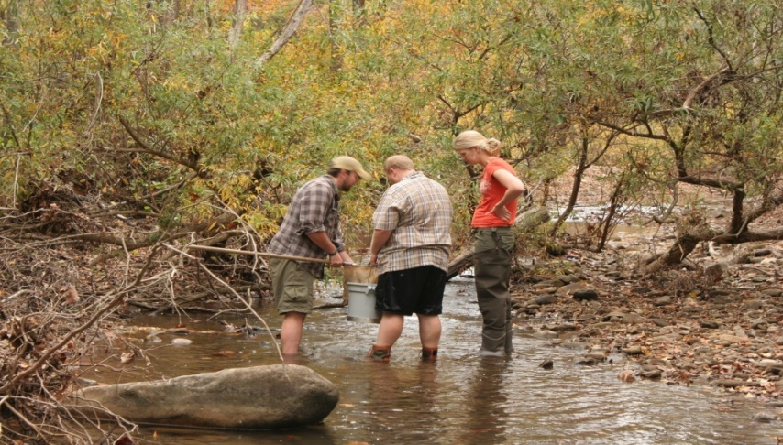
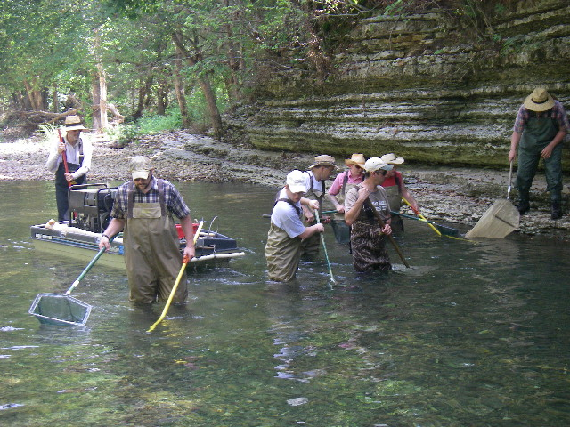
Water Quality Monitoring Network
WATERSHED MONITORING NETWORK
Macroinvertebrate Community
Ecoregion Based: 30-60 samples/year
Plus Routine Water Quality Analyses & Flow
Fish Community
Ecoregion Based: 30+ samples/year
Plus Routine Water Quality Analyses & Flow
Notes:
Continuing to work on projects such as the Lakes Projects, ERW Project, & working with Natural Heritage and BWD

Slide 19
Water Quality Monitoring Network
LAKES AND RESERVOIRS
16 lakes sampled quarterly since 2011
Other lakes sampled regularly in order to:
  Identify potential reference Lakes
  Verify reference conditions
  Collect adequate quantity of data
  Develop improved water quality standards for lakes
Notes:
Beaver Lake, Blue Mountain Lake, Bull Shoals Lake, Lake Catherine, Dierks Lake, DeGray Lake, DeQueen Lake, Gillham Lake, Greers Ferry Lake, Lake Greeson, Lake Hamilton, Lake Millwood, Lake Nimrod, Lake Norfork, & Lake Ouachita

Slide 20
Clean Water Act Requirements
Defines Water Quality goals
40 CFR 130.3 and 131
Adopt Water Quality Standards
Data collection based on need
40 CFR 130.4
Monitor Waters of the State
Determines attainment
40 CFR 130.8
Assessment
305(b) Integrated Report
Identifies Quality Limited Waters
40 CFR 130.7(b)(1)
List Impaired Waters
303(d) List
Defines Waste Loads
40 CFR 130.7
Develop TMDLs
Implementation
40 CFR Part 122
Develop Permit Limits

Slide 21
Clean Water Act Requirements
Defines Water Quality goals
40 CFR 130.3 and 131
Adopt Water Quality Standards
Data collection based on need
40 CFR 130.4
Monitor Waters of the State
Determines attainment
40 CFR 130.8
Assessment
305(b) Integrated Report
Identifies Quality Limited Waters
40 CFR 130.7(b)(1)
List Impaired Waters
303(d) List
Defines Waste Loads
40 CFR 130.7
Develop TMDLs
Implementation
40 CFR Part 122
Develop Permit Limits

Slide 22
Assessment Example: pH
pH Standard in Reg. 2.504
  pH between 6.0 and 9.0 standard units are the applicable standards for streams.
Assessment Methodology
  Stream ...segments will be listed as non-support ... when a variance from the pH standard ... (occurs) in more than 10% of the total samples within the period of record.

Slide 23

Assessment Example: pH
Example Data Set
The pH water quality criterion is 6.0-9.0.
3 of the 10 (greater than 10%) samples are outside the criterion.
If these were the only qualifying data available for this waterbody, it would be listed on the 303(d) List of Impaired Waterbodies.
Date | pH Result
2/12/2014 | 6.3
4/15/2014 | 5.7
6/18/2014 | 6.0
8/11/2014 | 6.2
10/14/2014 | 5.5
12/16/2014 | 5.4
2/10/2015 | 6.7
4/8/2015 | 6.3
6/13/2015 | 6.4
8/14/2016 | 6.0

Slide 24
303(d) Report Listing Format
Five Categories of Waters (continued)
  5 – Waters not meeting WQ Standards
    High
      Truly impaired, TMDL needed
    Medium
      Adoption of new regulations or standards
      Questionable data (QA/QC)
      Data verification needed
      Impairment caused by a point source
    Low
      Impairment is naturally occurring
      Segment added by EPA

Slide 25
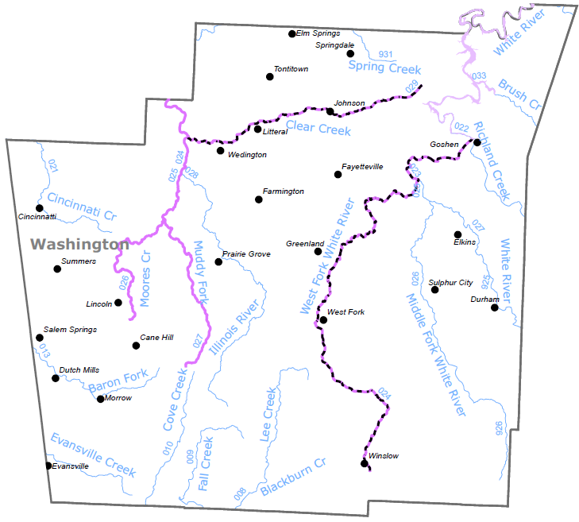
Draft 2016 Impaired Waterbodies

Slide 26
Clean Water Act Requirements
Defines Water Quality goals
40 CFR 130.3 and 131
Adopt Water Quality Standards
Data collection based on need
40 CFR 130.4
Monitor Waters of the State
Determines attainment
40 CFR 130.8
Assessment
305(b) Integrated Report
Identifies Quality Limited Waters
40 CFR 130.7(b)(1)
List Impaired Waters
303(d) List
Defines Waste Loads
40 CFR 130.7
Develop TMDLs
Implementation
40 CFR Part 122
Develop Permit Limits

Slide 27
Designated Use Support &
Water Quality Standards Attainment

Slide 28
De-Listing of Waters
Development of a TMDL
Implement control strategies other than a TMDL
Updated assessments indicate no known impairments
Improved delineation of impaired waterbodies
Revised water quality standards and assessment methodologies

Slide 29
De-Listings from 2014 to 2016
153 Pollutant Pairs
  Minerals - Cl, SO₄, TDS (45)
  Metals - Cu, Pb, Zn (49)
  Turbidity (29)
  pH (8)
  Dissolved Oxygen (8)
  Temperature (12)
  Pathogens (2)

Slide 30
New Listings for 2016
104 Pollutant Pairs
  Minerals - Cl, SO₄, TDS (19)
  Turbidity (3)
  Dissolved Oxygen (26)
  Metals - Cu, Pb, Zn, Se (13)
  Temperature (2)
  Pathogens (o)
  pH (7)

Slide 31
Updates
Assessment Methodology Stakeholder Workgroup
  Occurring now
  Public Comment Period this summer
Triennial Review Stakeholder Workgroup
  Stakeholder workgroup beginning Summer 2017

Slide 32

The Stakeholder Process
Identify Stakeholders
Gather Input
Discuss Input
Make Recommendations

Slide 33
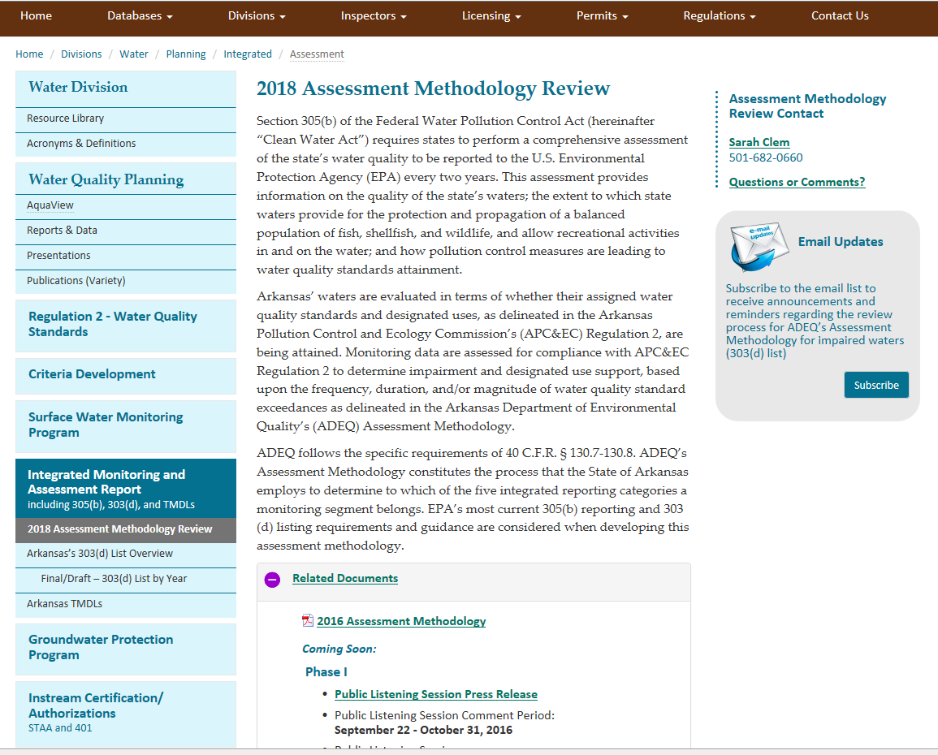

https://www.adeq.state.ar.us/water/
planning/integrated/assessment/
List serve
Drop Down Menu

